Slide 1

Flight Rescheduling problem
Quantum Machine Learning
Hugh Wan Jun Yuan
Supervised by:
Dr. Lei Pan
Dr. Sutharshan Rajasegarar
Notes:
Good morning/afternoon everyone and thank you for joining me today. My name is Wan Jun Yuan and I'll be speaking to you today about the flight rescheduling problem in regard to Quantum machine learning.

Slide 2

Problem
Combinatorial optimization problem that involves finding the optimal route for an aircraft to fly between multiple destinations.
goal is to minimize the total cost of the flight, which may include factors such as fuel consumption and maintenance costs
Modeled as a mixed integer programming (MIP) problem and is typically solved using mathematical optimization algorithms.
Notes:
- This is a combinatorial optimization problem that involves finding the best route for an aircraft to fly between multiple destinations.
Our goal is to minimize the total cost of the flight, which includes factors such as fuel consumption, maintenance, flight time and regulatory requirements.
The flight routing problem is modeled as a mixed integer programming (MIP) problem, which involves both integer and continuous variables that are typically solved with classical algorithms.

Slide 3

Motivation
There are many classical solutions for flight rescheduling problem
Only a handful of paper that attempts to solve flight rescheduling problem using quantum computing
The aim of the paper is to attempt to use a different quantum algorithms to solve flight rescheduling problem
Notes:
There are many classical solutions that have been proposed to solve this problem. However, only a handful of papers have attempted to solve this problem using quantum computing.
Our aim in this paper is to explore the potential of using different quantum algorithms to solve the flight rescheduling problem.

Slide 4

Research gaps
Difficulties in obtaining dataset and algorithms developed in other paper
Most previous work utilizes classical method
Many researchers did not disclose their method and makes it hard to build upon their work
Insufficient hardware resources for training and testing quantum machine learning algorithms.
The absence of well-established evaluation metrics and benchmark datasets for quantum machine learning.
The challenge of integrating classical machine learning techniques with quantum algorithms.
Notes:
Despite advancements in the development of algorithms, obtaining high-quality datasets remains a challenge. Additionally, many researchers have used classical methods in their work, making it difficult to build upon their findings.
Furthermore, the lack of disclosure of methods and insufficient hardware resources for training and testing quantum algorithms pose significant challenges.
To complicate matters further, there is currently a lack of well-established evaluation metrics and benchmark datasets for quantum machine learning.

Slide 5

Achievement
Two approaches using Qiskit and Quantum Circuit from IBM presented in the paper.
Reviewed literatures that uses classical method
Model encodes quantum approach to find the most optimized flight route between airports.
Model complexity with small sample size took approximately 1 hour to run.
Experiments show feasibility but more work needed for commercialization for wider public.
Notes:
Today I would like to share with you a new approach to optimizing flight routes using quantum computing. The paper presents two approaches using Qiskit and Quantum Circuit from IBM.
We attempted to optimize flight routes using the Quantum Optimiser class and encoded a quantum approach to find the most optimized flight route between airports. While the results showed feasibility, the model complexity with a small sample size took approximately 1 hour to run.

Slide 6
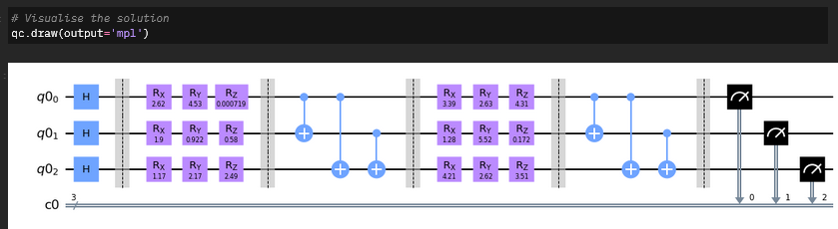
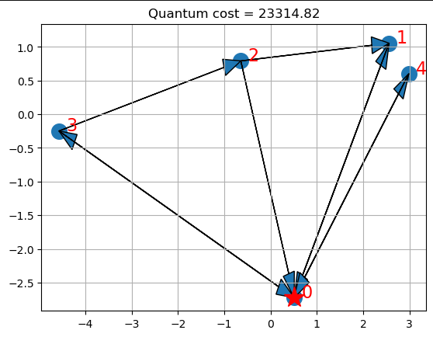
Artefact demo
Quantum Optimiser
Transform the combinatorial problem into a binary polynomial optimization problem with equality constraints only
Map the resulting problem into an Ising Hamiltonian for variables and basis, via penalty methods if necessary
encodes the quantum approach and solves the problem using VQE and MinimunEigenOptimizer.
Qiskit by IBM QuantumLab
Created a function that prepares qubits with Hadamard gates and random rotations, followed by CNOT gates and more rotations, ending with qubit measurement. It is repeated a specified number of times to find the optimal solution for the ARP problem.
encode the given distance between cities and Each city has a connection to another city, and each relationship carries a certain cost
Figure 2: Results from Quantum Circuit from IBM Qiskit
Figure 1: Results from Quantum Solution using VQE
Notes:
Our approach transforms the problem into a binary polynomial optimization problem with equality constraints only, and then maps it to an Ising Hamiltonian using variables and basis while using penalty method
Then we solve it using VQE and Minimum Eigen optimiser
Using IBM QuantumLab platform, Our method prepares qubits using Hadamard gates and random rotations, followed by CNOT gates and more rotations, and ends with qubit measurement. This process is repeated a specified number of times to find the optimal solution for the problem.
We encode the given distances between cities, where each city has a connection to another city, and each relationship carries a cost.

Slide 7
Future work
Quantum computers have the potential to solve scheduling issues in workflows.
The use of quantum technology has been demonstrated to be helpful for solving scheduling issues, but it is currently not profitable.
Research is being conducted to see if other optimization issues can be solved using IBM Quantum Experience quantum computers.
The use of quantum annealing, a quantum computing technique, is being researched as a potential solution for certain optimization problems, such as the ARP.
These approaches are still in the early stages of development and will likely take time to be applied in practice.
Notes:
As we all know, scheduling issues can be a major challenge in many industries, and finding a solution can have a significant impact on efficiency and productivity.
However, it is currently not profitable to use quantum technology to solve scheduling issues, and more research is needed in this area. This is where the IBM Quantum Experience comes in, as research is being conducted to see if other optimization issues can be solved using these quantum computers.
In conclusion, the potential of quantum computers in solving scheduling issues is exciting, and more research is needed in this area. Thank you for your attention, and I look forward to discussing this topic further.

Slide 8


Thank You

